Slide 1

Market-Mix Modelling
-Group 7

Slide 2



Objective
Performance Driver Analysis
Impact Analysis on Marketing ROI
Optimizing marketing spends

Slide 3
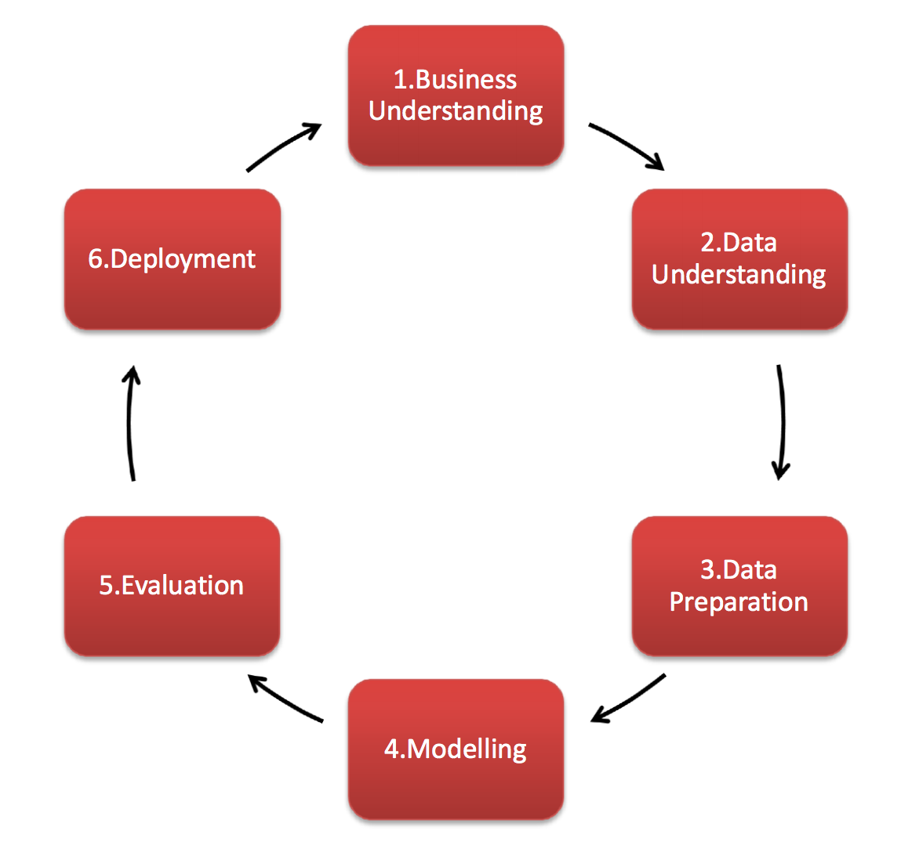
Project Framework

Slide 4
Data Description
Order Level Data
FSN ID: The unique identification of each SKU
Order Date: Date on which the order was placed
Order ID: The unique identification number of each order
Order item ID: different products under the same order generates different order Item IDs
GMV: Gross Merchandise Value or Revenue
Units: Number of units of the specific product sold
Order payment type: How the order was paid – prepaid or cash on delivery
SLA: Number of days it typically takes to deliver the product
Cust id: Unique identification of a customer
Product MRP: Maximum retail price of the product
Product procurement SLA: Time typically taken to procure the product
Other Data
Monthly spends on various advertising channels
Days when there was any special sale
Monthly NPS score – this may work as a proxy to ‘voice of customer’
As per the instruction data used from July 2015 to June 2016.

Slide 5
Product
Promotion
# of units sold
Delivery days and SLAs
Categories/sub categories
Marketing Channel Investments
Customer sentiment (NPS)
Discounts
Adstock
P
P
Product
Promotion
The Marketing Mix
Price
Price
Place
Place
Gmv
Product mrp
Pin code
Order Payment Type Place (& Time)
Week-of-the year– seasonality
Holiday/Events-Sale calendar
P
P

Slide 6
Data has been provided in the following files which has been uploaded in the project for analytics.
ConsumerElectronics.csv
Data Loading
Media data and other information.xlsx
Product Details.docx

Slide 7
Data Cleaning and Transformation
•Imputing "\N" value in deliverybdays & deliverycdays by 0 •Treating incorrect GMV values (where gmv > product_mrp * units) by imputing the faulty MRP values with GMV/units •Handling Negative values for product_procurement_sla, deliverybdays & deliverycdays by dropping them
After converting all column values to lower case, we see that there are around 99283 (6.33%) rows that are duplicates. We went ahead and dropped them
•Initially there weren’t any NULL values in the dataframe. However, there were quite a few Whitespaces present in some of the columns in the dataframe •We first converted these whitespaces to NaNs and the dropped these values
•Dropping Columns with Single Unique Value (as it doesn’t add any information to the analysis) •Dropping some of the ‘Id’ Columns which are insignificant to the analysis

Slide 8
Data Cleaning and Transformation Cont..
•Since we have already deleted some records on erroneous grounds, in order that we don't lose any further data, we chose not to delete outlier values Outlier Treatment •For the variables - 'SLA', 'deliverybdays', 'deliverybdays', 'gmv', 'product_mrp', 'list_price' where outliers are present, we CAPPED the values above 99 percentile to the value corresponding to 99 percentile •Thus the outliers couldn’t affect the predictive model while at the same time there was enough data to build a generalizable model
•Merging Order dataset with all other secondary dataframes
•Extracting 3 separate dataframes for 3 product subcategories - camera accessory
•Roll Up daily Order Data to Weekly Level by aggregating the numeric variables based on Week# •Scaling and dividing the master dataframes into train and test datasets for all 3 product subcategories
Binary encoding for categorical variable with 2 levels •One Hot Encoding for categorical variable with multiple levels by creating dummy variables

Slide 9
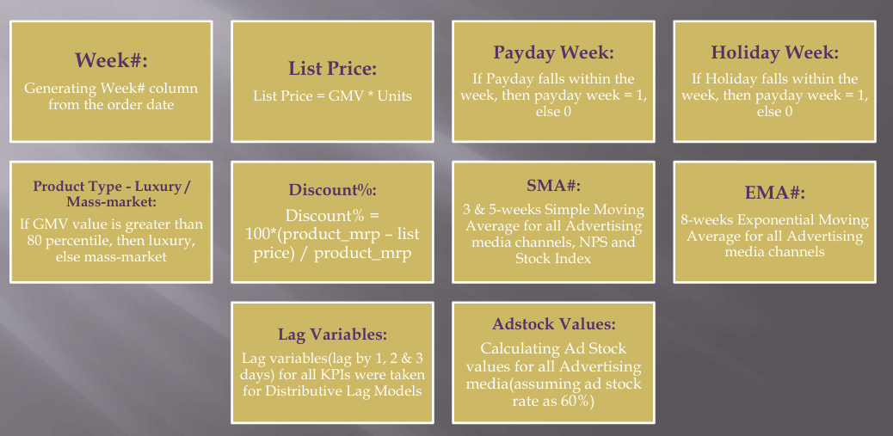
Feature Engineering and KPI Generation

Slide 10
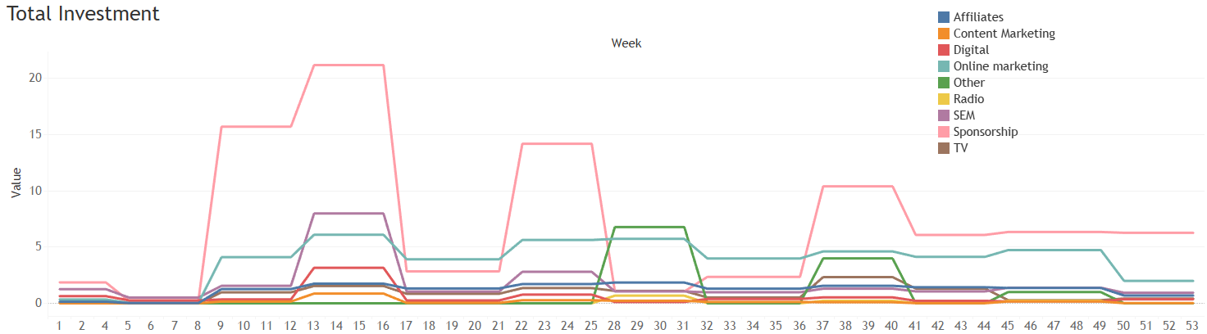
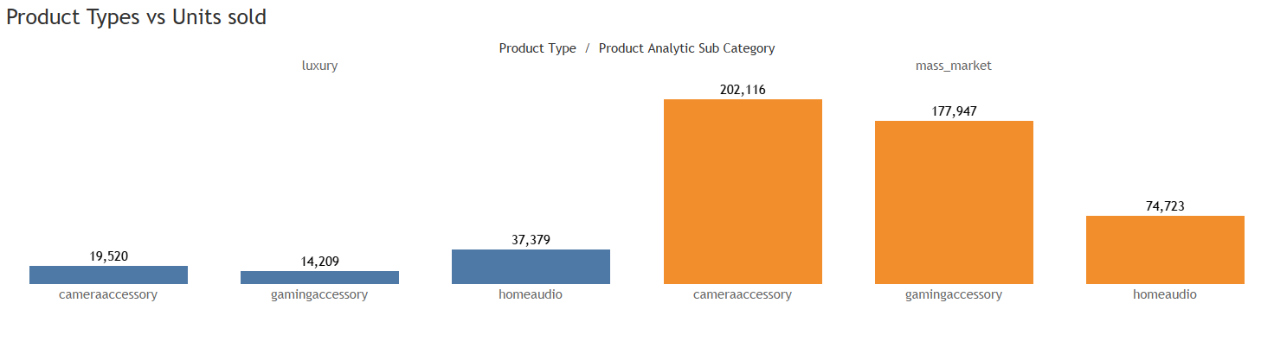
EDA & Visualization

Slide 11
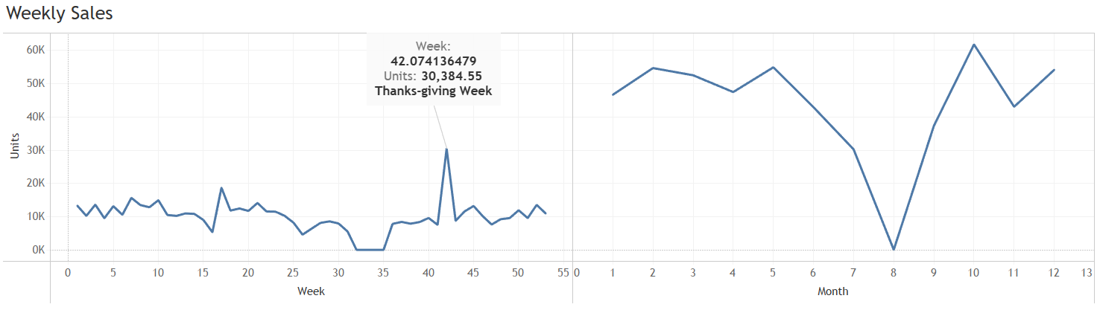
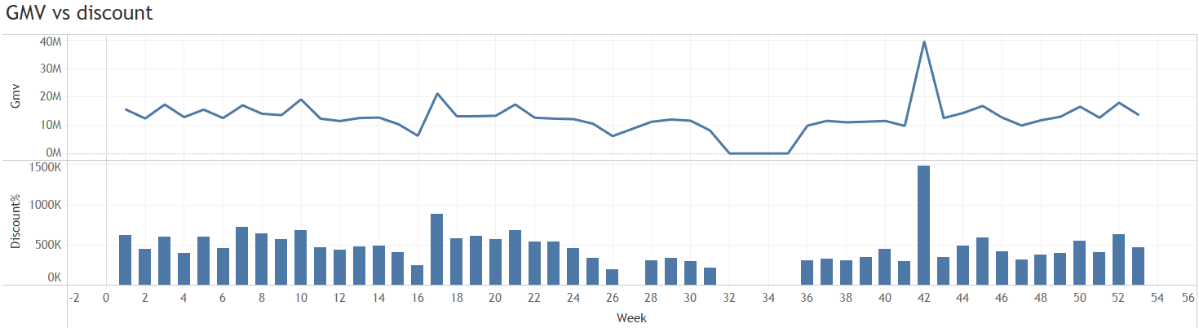
EDA & Visualization

Slide 12
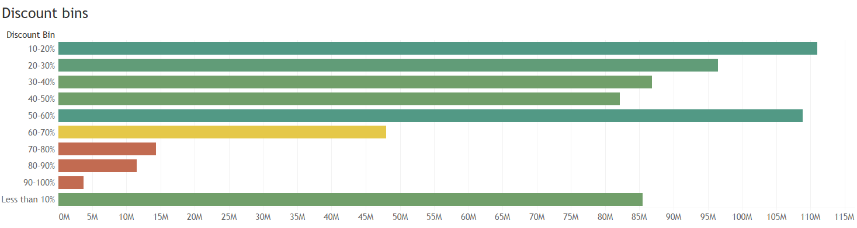
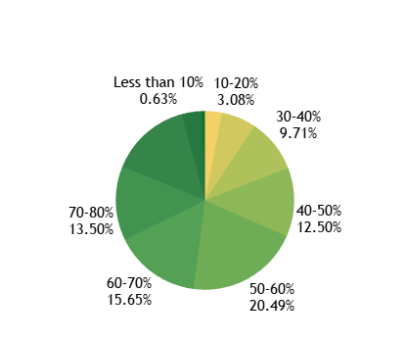
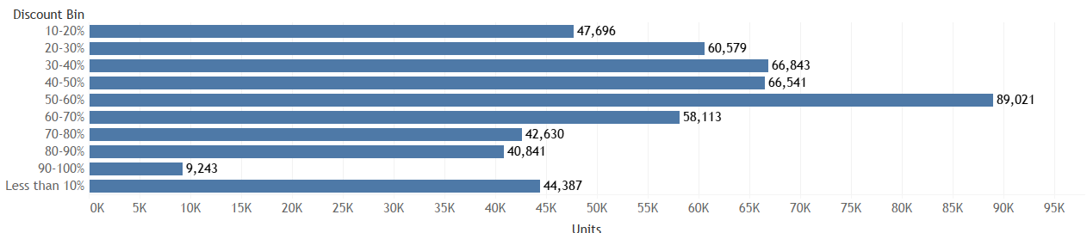
EDA & Visualization

Slide 13
Model Development
Linear Regression Model:
Linear model assumes an additive relationship between the different KPIs. Hence their impacts are also additive towards the dependent Y variable. The equation can be represented as:
Y = α + β1At + β2Pt + β3Dt + β4Qt + β5Tt + ϵ
Koyck model is used to capture the carry-over effect of different KPIs, ie.to model the current revenue figures based on the past figures of the KPIs. The Koyck tells us that the current revenue generated is not just influenced by the different independent attributes, but also because of the revenue generated over the last periods.
Yt=α+β1X1+β2X2+β3X3+β4X4+β5X5+ϵ • Yt=α+µYt-1+β1X1+β2X2+β3X3+β4X4+β5X5+ϵ

Slide 14
Model Development- Results
R2 Score: 0.855133435297494
Mean Squared Error: 0.17908377368019895
This is before cross validation which looks an adequate
training accuracy of 85.5% with 0.18 as MSE.
Although after Cross-validation we got the below results:
Cross-Predicted Accuracy: 0.6767401112451525
Mean Squared Error: 0.32325988875484746
Sr No | Features | Coefficients
1 | product_vertical_filter | 0.307
2 | product_vertical_lens | 0.248
3 | Snow on Grnd (cm) | 0.19
4 | product_vertical_camerabag | 0.139
5 | Total Snow (cm) | 0.138

Slide 15
Actionable Insights
For Camera Accessory Product Category:
Sales peak when the discount percentage falls between 50-60%, yet this doesn't significantly increase revenue. Exploratory Data Analysis (EDA) reveals that an average discount percentage between 10-20% is most profitable, particularly among luxury items.
Promote "Lens," "Camera Bag," and "Filters" for higher revenue.
Sponsorship spending positively affects revenue, with each unit correlating to a revenue boost of 0.036 units.
Content marketing spending has a negative impact on revenue.
Mass-market products contribute more significantly to increased revenue than luxury items.
Higher percentages of discounts within this product category tend to decrease revenue.
Snow on Ground is another interesting metric which boosts revenue as people tend to shop online during that weather, but it cannot be controlled by humans!

Slide 16
References
Gupta, Sunil. (2019). "Marketing Analytics: Data-Driven Techniques with Microsoft Excel."
John Wiley & Sons.
Hanssens, Dominique M., et al. (2020). "Market Response Models: Econometric and
Machine Learning Insights." Springer.
Neslin, Scott A., et al. (2019). "Sales Promotion and Retailing: Allowance for Marketing
Actions." Marketing Science.
Wang, Wes. (2018). "Marketing Analytics: A Practical Guide to Real Marketing Science."
Kogan Page.

